Slide 1
The AntonLeeSteveProject
The Traveller’s Friend.

Slide 2
Let us take you on a journey… We’re holding your hand all the way as you plan your next dream getaway. One site to plan your holiday from start to finish – currency exchange, map directions, and local knowledge, and more.

Slide 3
Concept
A holiday planning site.
Create a holiday planning site to bring in holiday advetising and booking.
Vistors can experiment with destinations, selecting different locations and choosing an amount of money to exchange.
Visitors can select a point on the map or search a country to view the national holidays for that country.

Slide 4
Process
HTML, Javascript, CSS and Bootstrap.
Google API’s - Places, Geocoding, and Maps Javascript.
ExchangeRate.Host API, OpenWeatherMap API, and Calendarific API.
The website naturally divided into three sections:
Anton coded the map, Lee the exchange conversion, and Steve the national holiday.
The fetched holiday data persists to local storage to save re-fetching.
Challenges overcome include API selection, creating error code for the exchange rate, localStorage storing of objects, the complexity of the Google API - understanding markers, layers, and InfoWindow.
Successes - Team communication, project planning, splitting tasks, GitHub, the look and functionality of the map.

Slide 5
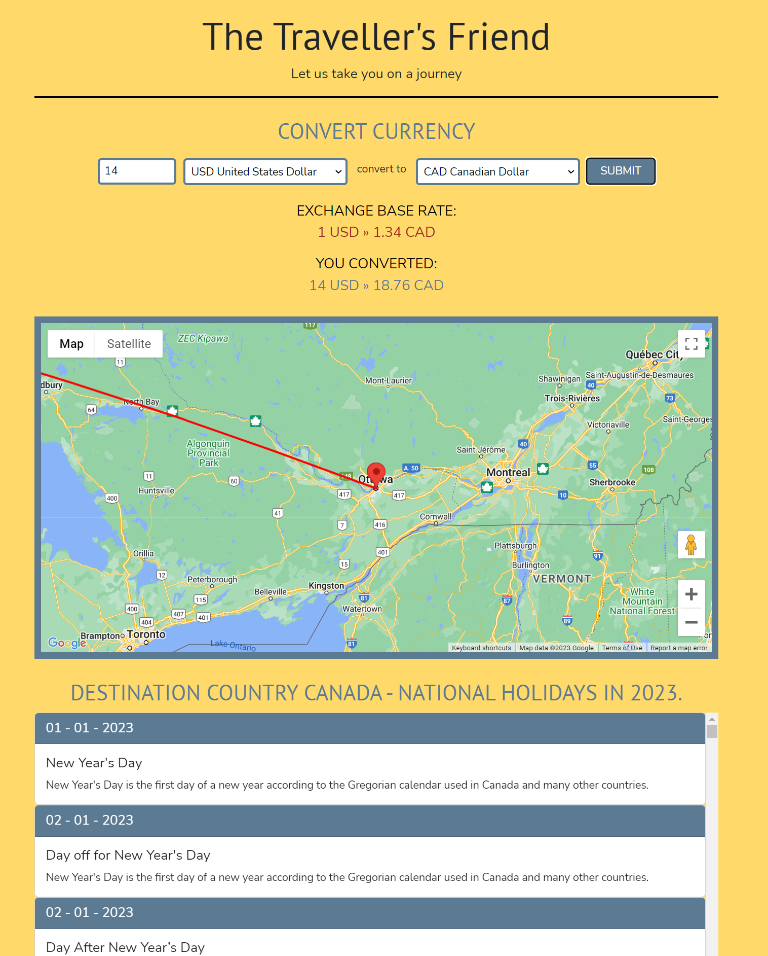

Slide 6
Directions for Future Development
Fully interactive map.
To include flight information.
To include hotel information.
Include weather information.
Get holiday companies to advertise.
Maybe develop into a holiday booking site.

Slide 7
Links
Website
https://s-r-i-c-e.github.io/TheAntonLeeSteveProject/
Repo
https://github.com/S-R-i-c-e/TheAntonLeeSteveProject

